Slide 1

Customer Prediction
Rashad Ahammed
LinkedIn: Rashad-Ahammed

Slide 2
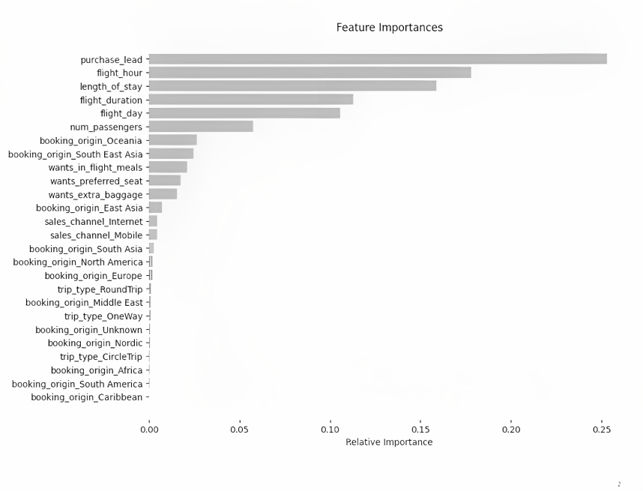
What we get from data

Slide 3
What we conclude from data
The model's precision and recall values were roughly 0.7 and 0.003, respectively, indicating that it still needs to be improved. I propose expanding the model's customer-focused features.
Purchase_lead, or the interval between a purchase and departure, was the most crucial variable in the model.
While the customer's booking origin was not crucial, flight information such as time and duration was important.

